Slide 1
Artificial Intelligence Unit 1 and Unit 2
Compiled By : Dr. Manish Sharma

Slide 2
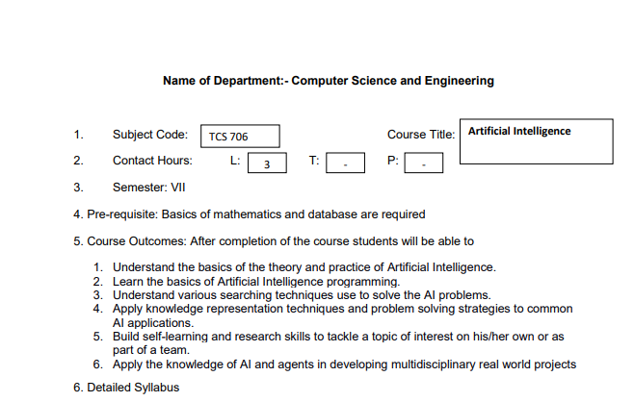

Slide 3
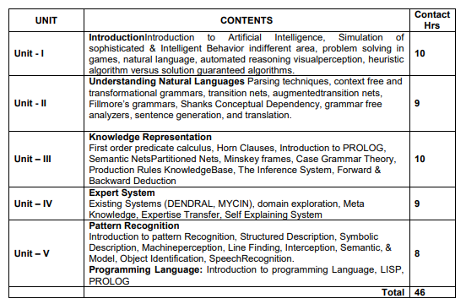

Slide 4
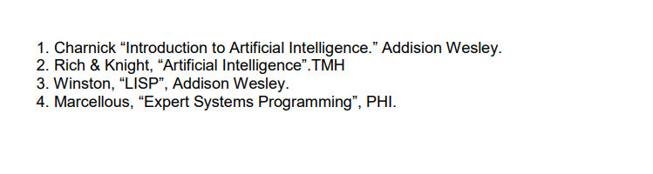

Text/ Reference Books

Slide 5
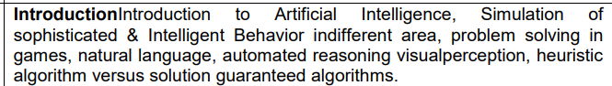
UNIT-01

Slide 6

What is Artificial Intelligence?
“The science and engineering of making intelligent machines, especially intelligent computer programs”.
by John McCarthy (1956)

Slide 7

Applications of AI

Slide 8




Programming Languages for AI

Slide 9
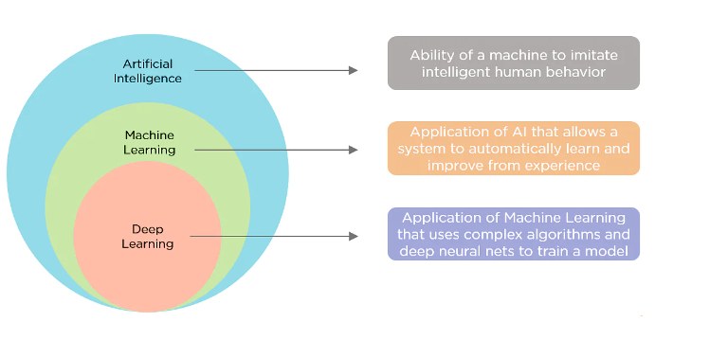
AI, Machine Learning and Deep Learning

Slide 10
Simulation of sophisticated and intelligent behavior in different areas
Simulation of sophisticated and intelligent behavior can be achieved by the following methods:
Turing Test
Agents
Application area of AI

Slide 11
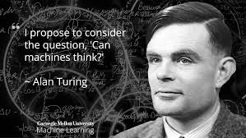
Turing Test
The Turing Test is a deceptively simple method of determining whether a machine can demonstrate human intelligence: If a machine can engage in a conversation with a human without being detected as a machine, it has demonstrated human intelligence.
The Turing Test was proposed in a paper published in 1950 by mathematician and computing pioneer Alan Turing. It has become a fundamental motivator in the theory and development of artificial Intelligence (AI).

Slide 12
Turing Test
The test is conducted in an interrogation room run by a judge. The test subjects, a person and a computer program, are hidden from view. The judge has a conversation with both parties and attempts to identify which is the human and which is the computer, based on the quality of their conversation. Turing concludes that if the judge can't tell the difference, the computer has succeeded in demonstrating human intelligence. That is, it can think.

Slide 13
Agents in Artificial Intelligence
Artificial intelligence is defined as the study of rational agents. A rational agent could be anything that makes decisions, as a person, firm, machine, or software. It carries out an action with the best outcome after considering past and current percepts(agent’s perceptual inputs at a given instance). An AI system is composed of an agent and its environment. The agents act in their environment. The environment may contain other agents.
An agent is anything that can be viewed as :
perceiving its environment through sensors and
acting upon that environment through actuators

Slide 14
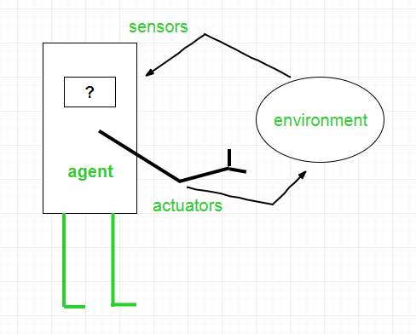
Examples of Agent:
A software agent has Keystrokes, file contents, received network packages which act as sensors and displays on the screen, files, sent network packets acting as actuators.
A Human-agent has eyes, ears, and
other organs which act as sensors,
and hands, legs, mouth, and other
body parts acting as actuators.
A Robotic agent has Cameras and
infrared range finders which act as
sensors and various motors acting
as actuators.

Slide 15
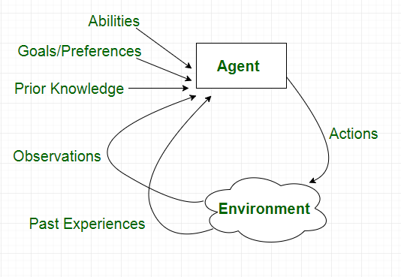

Slide 16
Types of Agent
Agents can be grouped into five classes based on their degree of perceived intelligence and capability :
Simple Reflex Agents
Model-Based Reflex Agents
Goal-Based Agents
Utility-Based Agents
Learning Agent

Slide 17
Simple reflex agents
Simple reflex agents ignore the rest of the percept history and act only on the basis of the current percept. Percept history is the history of all that an agent has perceived to date. The agent function is based on the condition-action rule. A condition-action rule is a rule that maps a state i.e, condition to an action. If the condition is true, then the action is taken, else not. This agent function only succeeds when the environment is fully observable. For simple reflex agents operating in partially observable environments, infinite loops are often unavoidable. It may be possible to escape from infinite loops if the agent can randomize its actions.

Slide 18
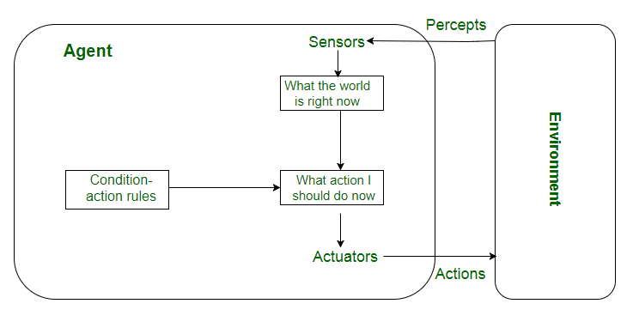
Problems with Simple reflex agents are :
Very limited intelligence.
No knowledge of non-perceptual parts of the state.
Usually too big to generate and store.
If there occurs any change in the environment, then the collection of rules need to be updated.

Slide 19
Model-based reflex agents
It works by finding a rule whose condition matches the current situation. A model-based agent can handle partially observable environments by the use of a model about the world. The agent has to keep track of the internal state which is adjusted by each percept and that depends on the percept history. The current state is stored inside the agent which maintains some kind of structure describing the part of the world which cannot be seen.

Slide 20
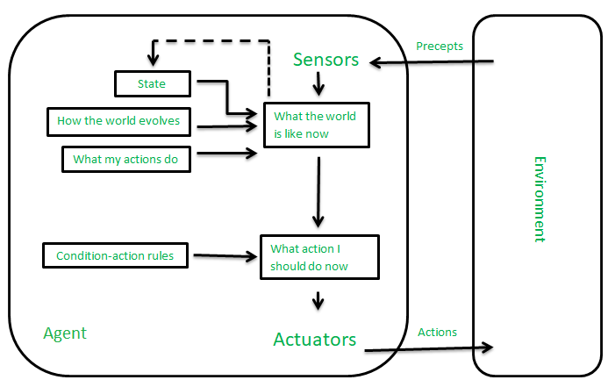
Updating the state requires information about :
how the world evolves independently from the agent, and
how the agent’s actions affect the world.

Slide 21
Goal-based agents
These kinds of agents take decisions based on how far they are currently from their goal(description of desirable situations). Their every action is intended to reduce its distance from the goal. This allows the agent a way to choose among multiple possibilities, selecting the one which reaches a goal state. The knowledge that supports its decisions is represented explicitly and can be modified, which makes these agents more flexible. They usually require search and planning. The goal-based agent’s behavior can easily be changed.

Slide 22
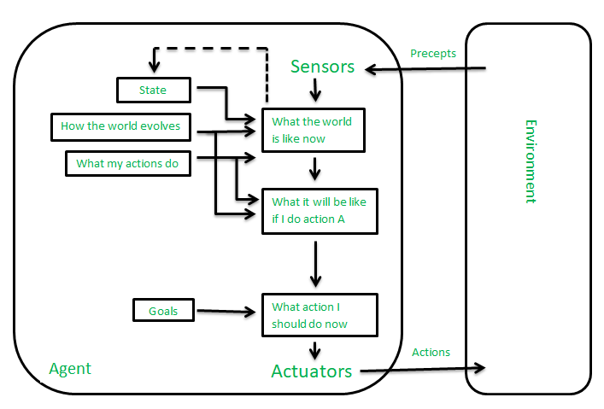

Slide 23
Utility-based agents
The agents which are developed having their end uses as building blocks are called utility-based agents. When there are multiple possible alternatives, then to decide which one is best, utility-based agents are used. They choose actions based on a preference (utility) for each state. Sometimes achieving the desired goal is not enough. We may look for a quicker, safer, cheaper trip to reach a destination. Agent happiness should be taken into consideration. Utility describes how “happy” the agent is. Because of the uncertainty in the world, a utility agent chooses the action that maximizes the expected utility. A utility function maps a state onto a real number which describes the associated degree of happiness.

Slide 24
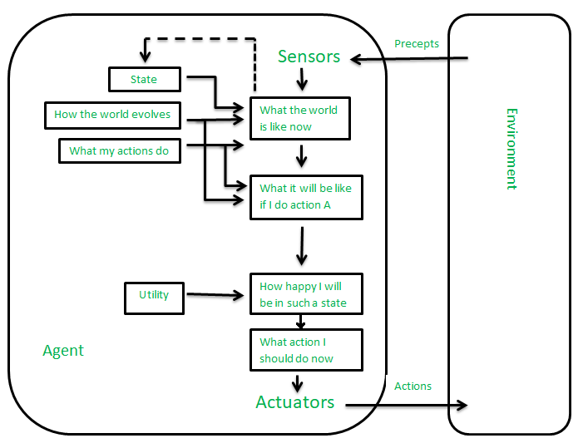

Slide 25
Learning Agent :
A learning agent in AI is the type of agent that can learn from its past experiences or it has learning capabilities. It starts to act with basic knowledge and then is able to act and adapt automatically through learning. A learning agent has mainly four conceptual components, which are:
Learning element: It is responsible for making improvements by learning from the environment
Critic: The learning element takes feedback from critics which describes how well the agent is doing with respect to a fixed performance standard.
Performance element: It is responsible for selecting external action
Problem Generator: This component is responsible for suggesting actions that will lead to new and informative experiences.

Slide 26
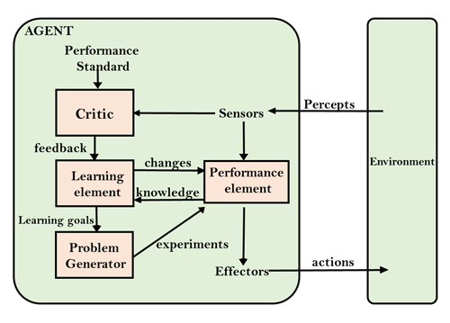

Slide 27

Application of AI

Slide 28
Problem solving in games
Problems are the issues which comes across any system. A solution is needed to solve that particular problem.
Solve problem using Artificial Intelligence:
The process of solving a problem consists of five steps.
These are:
Defining The Problem
Analyzing The Problem
Identification Of Solutions
Choosing a Solution
Implementation

Slide 29
Problem Solving in Artificial Intelligence
Defining The Problem: The definition of the problem must be included precisely. It should contain the possible initial as well as final situations which should result in acceptable solution.
Analyzing The Problem: Analyzing the problem and its requirement must be done as few features can have immense impact on the resulting solution.
Identification Of Solutions: This phase generates reasonable amount of solutions to the given problem in a particular range.
Choosing a Solution: From all the identified solutions, the best solution is chosen basis on the results produced by respective solutions.
Implementation: After choosing the best solution, its implementation is done.

Slide 30
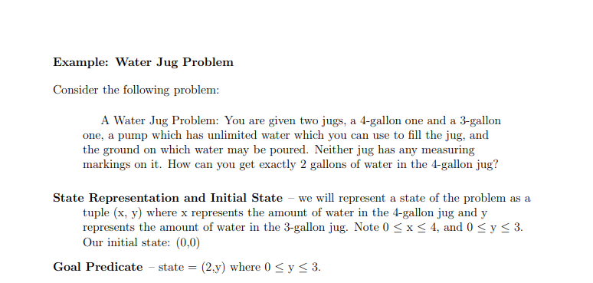

Slide 31
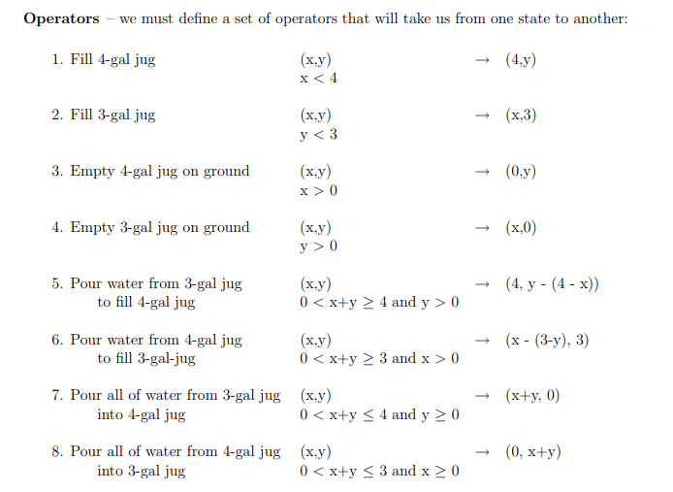

Slide 32
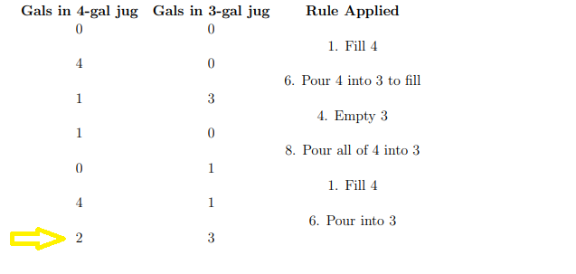

Slide 33
Natural Language
??

Slide 34
Automated reasoning
Automated reasoning is the area of computer science that is concerned with applying reasoning in the form of logic to computing systems. If given a set of assumptions and a goal, an automated reasoning system should be able to make logical inferences towards that goal automatically. Computers that use automated reasoning can be used to automate and apply logical reasoning to activities such as proving theorems, checking proofs or designing circuits. Automated reasoning can also use logic in the form of reasoning through analogy, induction, abduction and non-monotonic reasoning. However, the term automated reasoning is mostly used when referring to deductive reasoning in mathematics and logic.
Reasoning: is a process of drawing conclusion from facts.

Slide 35
Deductive reasoning:
Deductive reasoning is deducing new information from logically related known information. It is the form of valid reasoning, which means the argument's conclusion must be true when the premises are true.
Deductive reasoning is a type of propositional logic in AI, and it requires various rules and facts. It is sometimes referred to as top-down reasoning, and contradictory to inductive reasoning.
In deductive reasoning, the truth of the premises guarantees the truth of the conclusion.
Deductive reasoning mostly starts from the general premises to the specific conclusion, which can be explained as below example.

Slide 36

Deductive reasoning:
Example:
Premise-1: All the human eats veggies
Premise-2: Suresh is human.
Conclusion: Suresh eats veggies.

Slide 37
Inductive Reasoning:
Inductive reasoning is a form of reasoning to arrive at a conclusion using limited sets of facts by the process of generalization. It starts with the series of specific facts or data and reaches to a general statement or conclusion.
Inductive reasoning is a type of propositional logic, which is also known as cause-effect reasoning or bottom-up reasoning.
In inductive reasoning, we use historical data or various premises to generate a generic rule, for which premises support the conclusion.
In inductive reasoning, premises provide probable supports to the conclusion, so the truth of premises does not guarantee the truth of the conclusion.

Slide 38

Inductive Reasoning:
Example:
Premise: All of the pigeons we have seen in the zoo are white.
Conclusion: Therefore, we can expect all the pigeons to be white.

Slide 39
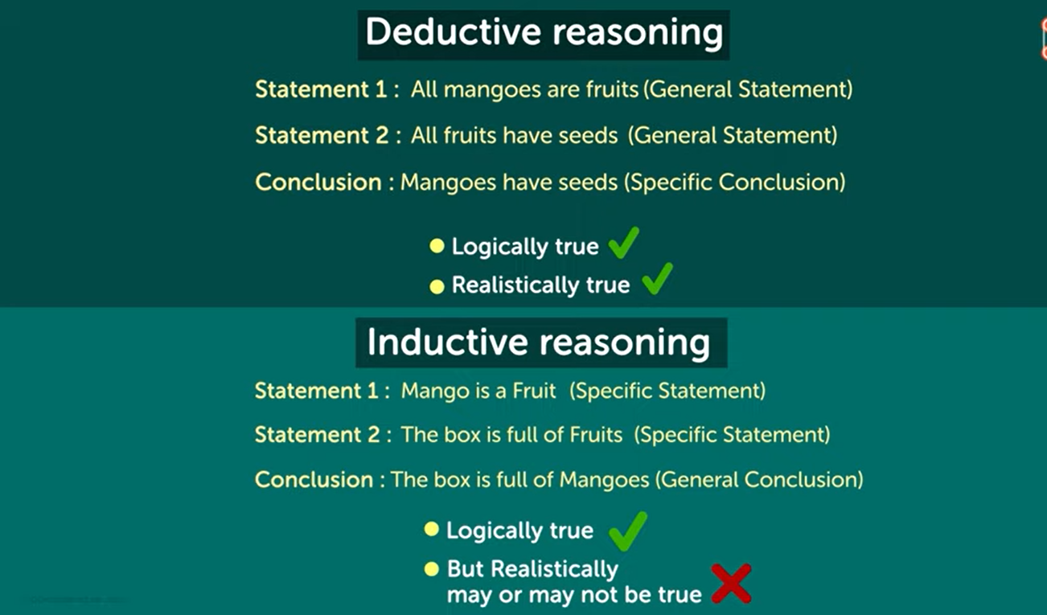

Slide 40
Abductive reasoning:
Abductive reasoning is a form of logical reasoning which starts with single or multiple observations then seeks to find the most likely explanation or conclusion for the observation.
Abductive reasoning is an extension of deductive reasoning, but in abductive reasoning, the premises do not guarantee the conclusion.
Example:
Implication: Cricket ground is wet if it is raining
Axiom: Cricket ground is wet.
Conclusion It is raining.

Slide 41
Heuristic Search

Slide 42
Heuristic Search Techniques
Direct techniques (blind search) are not always possible (they require too much time or memory).
Weak techniques can be effective if applied correctly on the right kinds of tasks.
Typically require domain specific information.

Slide 43
Example: 8 Puzzle
1
2
3
1
2
3
7
8
4
8
4
6
5
7
6
5

Slide 44
Which move is best?
1
2
3
GOAL
1
2
3
8
4
7
8
4
7
6
5
6
5
left
up
right
1
2
3
1
2
3
1
2
3
7
8
4
7
8
4
7
4
6
5
6
5
6
8
5

Slide 45
8 Puzzle Heuristics
Blind search techniques used an arbitrary ordering (priority) of operations.
Heuristic search techniques make use of domain specific information - a heuristic.
What heurisitic(s) can we use to decide which 8-puzzle move is “best” (worth considering first).

Slide 46
8 Puzzle Heuristics
For now - we just want to establish some ordering to the possible moves (the values of our heuristic does not matter as long as it ranks the moves).
Later - we will worry about the actual values returned by the heuristic function.

Slide 47
A Simple 8-puzzle heuristic
Number of tiles in the correct position.
The higher the number the better.
Easy to compute (fast and takes little memory).
Probably the simplest possible heuristic.

Slide 48
Another approach
Number of tiles in the incorrect position.
This can also be considered a lower bound on the number of moves from a solution!
The “best” move is the one with the lowest number returned by the heuristic.
Is this heuristic more than a heuristic (is it always correct?).
Given any 2 states, does it always order them properly with respect to the minimum number of moves away from a solution?

Slide 49
1
2
3
GOAL
1
2
3
8
4
7
8
4
7
6
5
6
5
left
up
right
1
2
3
1
2
3
1
2
3
7
8
4
7
8
4
7
4
6
5
6
5
6
8
5
h=2
h=4
h=3

Slide 50
Another 8-puzzle heuristic
Count how far away (how many tile movements) each tile is from it’s correct position.
Sum up this count over all the tiles.
This is another estimate on the number of moves away from a solution.

Slide 51
1
2
3
GOAL
1
2
3
8
4
7
8
4
7
6
5
6
5
left
up
right
1
2
3
1
2
3
1
2
3
7
8
4
7
8
4
7
4
6
5
6
5
6
8
5
h=2
h=4
h=4

Slide 52
Techniques
There are a variety of search techniques that rely on the estimate provided by a heuristic function.
In all cases - the quality (accuracy) of the heuristic is important in real-life application of the technique!

Slide 53
Generate-and-test
Very simple strategy - just keep guessing.
do while goal not accomplished
generate a possible solution
test solution to see if it is a goal
Heuristics may be used to determine the specific rules for solution generation.
Notes:
Generating a solution may mean moving in the state space, or perhaps constructing a path through the state space. The path may end at a goal state, in which case we are done.
If a systematic mechanism for generation is used the algorithm can always find the best solution.
Random generation may work in some domains.
Depth first search since complete solutions are generated before they can be tested.

Slide 54
Example - Traveling Salesman Problem (TSP)
Traveler needs to visit n cities.
Know the distance between each pair of cities.
Want to know the shortest route that visits all the cities once.
n=80 will take millions of years to solve exhaustively!

Slide 55
TSP Example
A
B
6
1
2
5
3
D
C
4
Notes:
ABCD = 18
BACD = 13 - take it
ABCD = 18 - nope
BCAD - 11 - take it (is the optimum)
CBAD - 18
BACD - 13
BCDA - 18
DCAB - 13 nope

Slide 56
Generate-and-test Example
TSP - generation of possible solutions is done in lexicographical order of cities:
1. A - B - C - D
2. A - B - D - C
3. A - C - B - D
4. A - C - D - B
...
A
B
C
D
B
C
D
C
D
B
D
C
B
D
C
D
B
B
C
Notes:
Characteristics with generate-and-test:
Requires that an entire possible solution is generated at each step, which may
be expensive
It may be difficult to develop a generation scheme that provides a
good order.
The big problem is that the algorithm is blind - it does not make use of any
knowledge that becomes available during the search.
1. Can modify to use brand-and-bound techniques to skip some solutions.
2. Perhaps we can use information about the likelyhood of success to change
the generated possible solutions.
IMPORTANT: TSP is a bad example because it is hard to see the state space. Consider a problem like the water jug problem and describe how this algorithm would work in that domain.

Slide 57
Hill Climbing
Variation on generate-and-test:
generation of next state depends on feedback from the test procedure.
Test now includes a heuristic function that provides a guess as to how good each possible state is.
There are a number of ways to use the information returned by the test procedure.
Notes:
The term hill climbing assumes we are talking about finding a maximum, but the concepts apply to minimization problems as well.
Remember that the heuristic is a rule of thumb or guess based on less than complete information. We assume that construction of a perfect heuristic is impossible (otherwise it would be the search).

Slide 58
Simple Hill Climbing
Use heuristic to move only to states that are better than the current state.
Always move to better state when possible.
The process ends when all operators have been applied and none of the resulting states are better than the current state.
Notes:
Always climb uphill whenever you can, without looking around.
Climbing a mountain in the dark - test one direction and if it is uphill take a step in that direction. If you find that there is no uphill move in any direction you are done (at the top of the mountain).

Slide 59
Simple Hill Climbing Function Optimization
y = f(x)
y
x
Notes:
Assuming the heuristic can be viewed as a function of the current state, all heuristic search can be modeled as function optimization in which we wish to
maximize/minimize the value of the heuristic function.
NOTES:
must define the operators!
Small move left, big move left, large moves, etc.
Change the order of operators and see what happens.
“climbing” vs. “descending” - same problem.

Slide 60
Potential Problems with Simple Hill Climbing
Will terminate when at local optimum.
The order of application of operators can make a big difference.
Can’t see past a single move in the state space.

Slide 61
Simple Hill Climbing Example
TSP - define state space as the set of all possible tours.
Operators exchange the position of adjacent cities within the current tour.
Heuristic function is the length of a tour.
Notes:
Note the transformation of the state space into one that involves a potential solution at each state. This will result in something different than if we
define the state space as incomplete tours!

Slide 62
TSP Hill Climb State Space
ABCD
Initial State
Swap 1,2
Swap 2,3
Swap 3,4
Swap 4,1
BACD
ACBD
ABDC
DBCA
Swap 1,2
Swap 3,4
Swap 2,3
Swap 4,1
CABD
ABCD
ACDB
DCBA
Notes:
Lots of loops
Each tour has many representations (toy problem)!

Slide 63
Steepest-Ascent Hill Climbing
A variation on simple hill climbing.
Instead of moving to the first state that is better, move to the best possible state that is one move away.
The order of operators does not matter.
Not just climbing to a better state, climbing up the steepest slope.
Notes:
Go through examples:
function optimization - choice of points fixes valley problem.
Multidimensional problems
TSP - new order of states. Example will find best right awat.

Slide 64
Hill Climbing Termination
Local Optimum: all neighboring states are worse or the same.
Plateau - all neighboring states are the same as the current state.
Ridge - local optimum that is caused by inability to apply 2 operators at once.
Notes:
Example of ridge is clear in the water jug problem.
Need to define a heuristic for the water jug problem that takes this in to account.

Slide 65
Heuristic Dependence
Hill climbing is based on the value assigned to states by the heuristic function.
The heuristic used by a hill climbing algorithm does not need to be a static function of a single state.
The heuristic can look ahead many states, or can use other means to arrive at a value for a state.
Notes:
The point is that the hill climbing is with respect to the heuristic function, which may not be directly related to the immediate value of a single state.
Example: TSP - could have a heuristic that looks at the path 4 cities ahead.
Example: Could devise a heuristic that looks for ridges in the simple evaluation space and adds a “ridge factor”.
Example: Can use constraints to modify the heuristic function - penalties for points that are not feasible.
Can transform the optimization function to one with better characteristics (perhaps fewer local optimum), although at a cost. The search is basically a bunch of calls to the heuristic function, so the cost of this function is critical.

Slide 66
Best-First Search
Combines the advantages of Breadth-First and Depth-First searchs.
DFS: follows a single path, don’t need to generate all competing paths.
BFS: doesn’t get caught in loops or dead-end-paths.
Best First Search: explore the most promising path seen so far.

Slide 67
Best-First Search (cont.)
While goal not reached:
1. Generate all potential successor states and add to a list of states.
2. Pick the best state in the list and go to it.
Similar to steepest-ascent, but don’t throw away states that are not chosen.
Notes:
Space requirements are a problem...
Modified version called “beam search” keeps on the N most promising states around.

Slide 68
Simulated Annealing
Based on physical process of annealing a metal to get the best (minimal energy) state.
Hill climbing with a twist:
allow some moves downhill (to worse states)
start out allowing large downhill moves (to much worse states) and gradually allow only small downhill moves.
Notes:
Proability of jumping to a state of higher energy is given by exponential function p = exp(-deltaE/t).

Slide 69
Simulated Annealing (cont.)
The search initially jumps around a lot, exploring many regions of the state space.
The jumping is gradually reduced and the search becomes a simple hill climb (search for local optimum).
Notes:
Algorithm:
use next operator to generate a new state.
Evaluate the state (heuristic function)
with probability p(t), move to the better state.
P(t) is roughly exponentially decreasing with respect to time (number of steps).

Slide 70
Simulated Annealing
7
6
2
4
3
5
1
Notes:
Marble analogy - increased temperature means we are shaking the curve around so that it can bound out of troughs. As temperature decreases - bounces are not so high, so we get trapped by the largest peaks...

Slide 71
A* Algorithm (a sure test topic)
The A* algorithm uses a modified evaluation function and a Best-First search.
A* minimizes the total path cost.
Under the right conditions A* provides the cheapest cost solution in the optimal time!

Slide 72
A* evaluation function
The evaluation function f is an estimate of the value of a node x given by:
f(x) = g(x) + h’(x)
g(x) is the cost to get from the start state to state x.
h’(x) is the estimated cost to get from state x to the goal state (the heuristic).
Notes:
Some notes about g and h’
If g is 0, this is just a greedy algorithm - it always picks what looks like the most promising path to the goal.
If h’ is 0 and g is always 1, the search will be a breadth first search, since the cost of each path will be the length of the path.

Slide 73
Modified State Evaluation
Value of each state is a combination of:
the cost of the path to the state
estimated cost of reaching a goal from the state.
The idea is to use the path to a state to determine (partially) the rank of the state when compared to other states.
This doesn’t make sense for DFS or BFS, but is useful for Best-First Search.
Notes:
The cost of a path is determined completely by the operators. Consider a TSP problem - we record the length of the intermeediate path.
Water jug problem - we record the number of steps, or perhaps the amount of water used so far.

Slide 74
Why we need modified evaluation
Consider a best-first search that generates the same state many times.
Which of the paths leading to the state is the best ?
Recall that often the path to a goal is the answer (for example, the water jug problem)

Slide 75
A* Algorithm
The general idea is:
Best First Search with the modified evaluation function.
h’(x) is an estimate of the number of steps from state x to a goal state.
loops are avoided - we don’t expand the same state twice.
Information about the path to the goal state is retained.
Notes:
IMPORTANT: A* keeps a list of nodes (it keeps 2 lists), so that the size complexity is often the limiting factor.

Slide 76
A* Algorithm
1. Create a priority queue of search nodes (initially the start state). Priority is determined by the function f )
2. While queue not empty and goal not found:
get best state x from the queue.
If x is not goal state:
generate all possible children of x (and save path information with each node).
Apply f to each new node and add to queue.
Remove duplicates from queue (using f to pick the best).

Slide 77
Example - Maze
START
GOAL

Slide 78
Example - Maze
START
GOAL

Slide 79
A* Optimality and Completeness
If the heuristic function h’ is admissible the algorithm will find the optimal (shortest path) to the solution in the minimum number of steps possible (no optimal algorithm can do better given the same heuristic).
An admissible heuristic is one that never overestimates the cost of getting from a state to the goal state (is pessimistic).

Slide 80
Admissible Heuristics
Given an admissible heuristic h’, path length to each state given by g, and the actual path length from any state to the goal given by a function h.
We can prove that the solution found by A* is the optimal solution.

Slide 81
A* Optimality Proof
Assume A* finds the (suboptimal) goal G2 and the optimal goal is G.
Since h’ is admissible: h’(G2)=h’(G)=0
Since G2 is not optimal: f(G2) > f(G).
At some point during the search some node n on the optimal path to G is not expanded. We know:
f(n)  f(G)

Slide 82
Proof (cont.)
We also know node n is not expanded before G2, so:
f(G2)  f(n)
Combining these we know:
f(G2)  f(G)
This is a contradiction ! (G2 can’t be suboptimal).

Slide 83
root (start state)
n
G
G2

Slide 84


A* Example Towers of Hanoi
Little Disk
Peg 1
Peg 3
Peg 2
Big Disk
Move both disks on to Peg 3
Never put the big disk on top the little disk
Notes:
Path cost function g is the number of moves so far.
Heuristic could be:
- number of tiles in incorrect position (certainly an underestimate of # moves).
- sum of distances of tiles from the right position
Go through an example, deriving the tree for the A* algorithm and this problem.

Slide 86
Problem Solving by Search

Slide 87
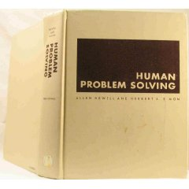
Introduction
Search is a central topic in AI.
Originated with Newell and Simon’s work on problem solving;
Human Problem Solving (1972).
Automated reasoning is a natural search task.
More recently: Given that almost all AI formalisms
(planning, learning, etc) are NP-Complete or worse,
some form of search is generally unavoidable
(i.e., no smarter algorithm available).

Slide 88
Outline
Problem-solving agents
Problem types
Problem formulation
Example problems
Basic search algorithms

Slide 89
Problem-solving agents
More details on “states” soon.
Problem solving agents are goal-directed agents:
Goal Formulation: Set of one or more (desirable) world states (e.g. checkmate in chess).
Problem formulation: What actions and states to consider given a goal and an initial state.
Search for solution: Given the problem, search for a solution --- a sequence of actions to achieve the goal starting from the initial state.
4. Execution of the solution
Note: Formulation feels somewhat “contrived,” but was meant
to model very general (human) problem solving process.

Slide 90

Example: Path Finding problem
Formulate goal:
be in Bucharest (Romania)
Formulate problem:
action: drive between pair of connected cities (direct road)
state: be in a city
(20 world states)
Find solution:
sequence of cities leading from start to goal state, e.g., Arad, Sibiu, Fagaras, Bucharest
Execution
drive from Arad to Bucharest according to the solution
Initial
State
Goal
State
Environment: fully observable (map),
deterministic, and the agent knows effects
of each action. Is this really the case?
Note: Map is somewhat of a “toy” example. Our real interest: Exponentially large spaces, with e.g. 10^100 or more states. Far beyond full search. Humans can often still handle those!
One of the mysteries of cognition.

Slide 91
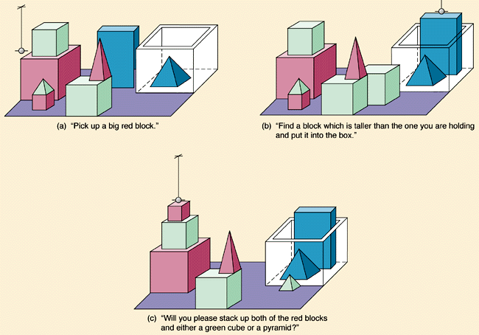
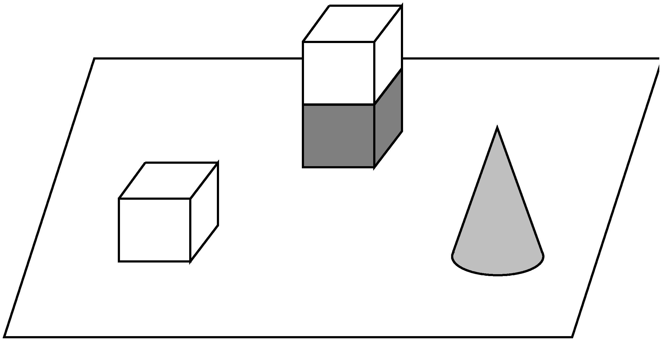
Micro-world: The Blocks World
gripper
How many
different possible
world states?
a) Tens?
b) Hundreds?
c) Thousands?
d) Millions?
e) Billions?
f) Trillions?
A
D
D
A
B
C
C
T
Initial State
Goal State

Slide 92
Size state space of blocks world example
n = 8 objects, k = 9 locations to build towers, one gripper. (One location in box.)
All objects distinguishable, order matter in towers. (Assume stackable
in any order.)
Blocks: Use r-combinations approach from Rosen (section 5.5; CS-2800).
- - - - - - - - - - - - - - - - consider 16 = (n + k – 1) “spots”
Select k – 1 = 8 “dividers” to create locations,
(16 choose 8) ways to do this, e.g.,
| | - - - | - | | - - - | | - | Allocate n = 8 objs to remaining spots, 8! ways, e.g.,
| | 4 1 8 | 5 | | 6 3 7 | | 2 | assigns 8 objects to the 9 locations
a b c d e f g h i based on dividers
So, total number of states (ignoring gripper): (16 choose 8) * 8! = 518,918,400
* 9 for location gripper: > 4.5 billion states even in this toy domain!
Search spaces grow exponentially with domain. Still need to search them, e.g., to
find a sequence of states (via gripper moves) leading to a desired goal state.

Slide 93
Problem types
1) Deterministic, fully observable
Agent knows exactly which state it will be in; solution is a sequence of actions.
2) Non-observable --- sensorless problem
Agent may have no idea where it is (no sensors); it reasons in terms of belief states; solution is a sequence actions (effects of actions certain).
3) Nondeterministic and/or partially observable: contingency problem
Actions uncertain, percepts provide new information about current state (adversarial problem if uncertainty comes from other agents).
Solution is a “strategy” to reach the goal.
4) Unknown state space and uncertain action effects: exploration problem
-- Solution is a “strategy” to reach the goal (end explore environment).
Increasing complexity

Slide 94
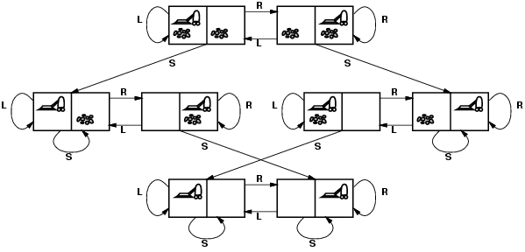
Example: Vacuum world state space graph
Start state
Goal
(reach one in
this set of states)
states?
actions?
goal test?
path cost?
The agent is in one of 8 possible world states.
Left, Right, Suck [simplified: left out No-op]
No dirt at all locations (i.e., in one of bottom two states).
1 per action
Minimum path from Start to Goal state:
Alternative, longer plan:
3 actions
4 actions
Note: path with thousands of steps before reaching goal also exist.

Slide 95

Example: The 8-puzzle “sliding tile puzzle”
Aside:
variations
on goal state.
eg empty square
bottom right or
in middle.
states? the boards, i.e., locations of tiles
actions? move blank left, right, up, down
goal test? goal state (given; tiles in order)
path cost? 1 per move
Note: finding optimal solution of n-puzzle family is NP-hard!
Also, from certain states you can’t reach the goal.
Total number of states 9! = 362,880 (more interesting space;
not all connected… only half can reach goal state)

Slide 96
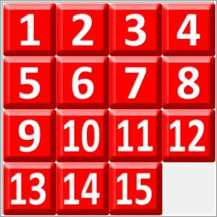
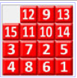
15-puzzle
Goal state
Search space:
16!/2 = 1.0461395 e+13,
about 10 trillion.
Too large to store in RAM
(>= 100 TB). A challenge to search
for a path from a given board to goal.
Korf:
Disk errors
become a
problem.
Longest minimum path: 80 moves. Just 17 boards, e.g,
Average minimum soln. length: 53.
People can find solns. But not necessarily
minimum length. See solve it! (Gives strategy.)
Korf, R., and Schultze, P. 2005. Large-scale parallel breadth-first search. In Proceedings of the 20th National Conference on Artificial Intelligence (AAAI-05).
See Fifteen Puzzle Optimal Solver. With effective search: opt. solutions in seconds!
Average: milliseconds.

Slide 97
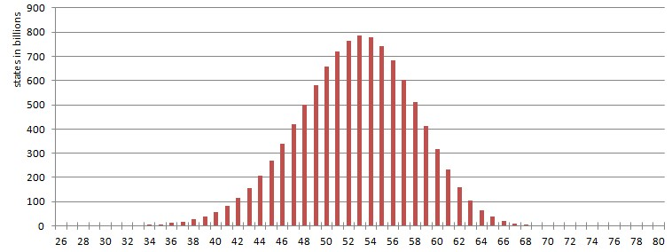
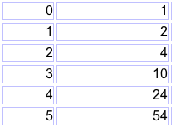
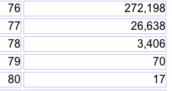
Where are the 10 trillion states?
# states in billions
minimum distance from goal state (# moves)
dist.
# states
dist.
# states
etc.

Slide 98
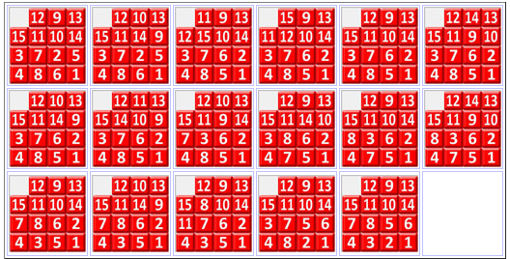
4
17 boards farthest away from goal state (80 moves)
1
13
<2,5,6>
?
<15,12,11>/
<9,10,14>
?
What is it about these 17 boards out of over 10 trillion?
?
Each require 80 moves to reach:
Intriguing similarities. Each number has its own few locations.
<3,7,8>
Interesting machine learning task:
Learn to recognize the hardest boards!
(Extremal Combinatorics, e.g. LeBras, Gomes, and Selman AAAI-12)

Slide 99
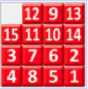
17 boards farthest away from goal state (80 moves)
Most regular extreme case:
Goal state
Each quadrant
reflected along
diagonal. “move
tiles furthest away”
Thanks to Jonathan GS

Slide 100
A few urls:
Play the eight puzzle on-line
Play the fifteen puzzle on-line
Let’s consider the search for a solution.

Slide 101
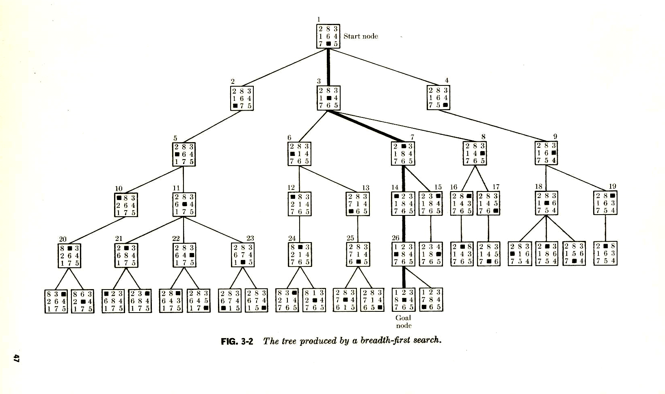
Searching for a solution
to the 8-puzzle.
Start state
Aside: in this tree, immediate
duplicates are removed.
Goal
A breadth-first search tree. (More detail soon.)
Branching factor 1, 2, or 3 (max). So, approx. 2 --- # nodes roughly doubles at each level. Number states of explored nodes grows exponentially with depth.

Slide 102
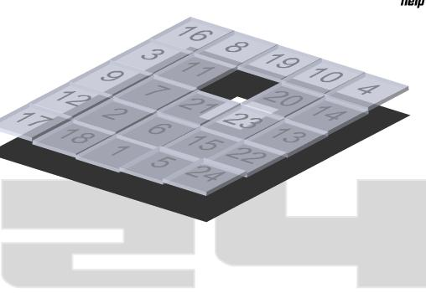
For 15-puzzle, hard initial states: 80 levels deep, requires
exploring approx. 2^80 ≈ 10^24 states.
If we block all duplicates, we get closer to 10 trillion (the number of
distinct states: still a lot!).
Really only barely feasible on compute cluster with lots of memory and
compute time. (Raw numbers for 24 puzzle, truly infeasible.)
Can we avoid generating all these boards? Do with much less search?
(Key: bring average branching factor down.)

Slide 103
Gedanken experiment: Assume that you knew for each state, the minimum
number of moves to the final goal state. (Table too big, but assume there is
some formula/algorithm based on the board pattern that gives this number
for each board and quickly.)
Using the minimum distance information, is there a clever way to find a
minimum length sequence of moves leading from the start state to the goal
state? How?

Slide 104
d = min dist. to goal
Hmm. How do I know?
d = 5
Start state
Note: at least one neighbor with d = 4.
d >= 5
Select
d = 4
d >= 4
d >= 4
Select
d = 3
d >= 3
d = 2
Select
Select
d = 1
Select
d = 0
d >= 1
Goal
A breadth-first search tree. (More detail soon.)
Branching factor approx. 2. So, with “distance oracle” we only need
to explore approx. 2 * (min. solution length).

Slide 105
For 15-puzzle, hard initial states: 80 levels deep, requires exploring
approx. 2^80 ≈ 10^24 states.
But, with distance oracle, we only need to explore roughly 80 * 2 = 160
states! (only linear in size of solution length)
We may not have the exact distance function (“perfect heuristics”), but
we can still “guide” the search using an approximate distance function.
This is the key idea behind “heuristic search” or “knowledge-based search.”
We use knowledge / heuristic information about the distance to the goal to
guide our search process. We can go from exponential to polynomial or even
linear complexity. More common: brings exponent down significantly.
E.g. from 2^L to 2^(L/100).
The measure we considered would be the “perfect” heuristic. Eliminates tree
search! Find the right “path” to goal state immediately.

Slide 106
Basic idea: State evaluation function can effectively guide search.
Also in multi-agent settings. (Chess: board eval.)
Reinforcement learning: Learn the state eval function.
Start state
Goal
A breadth-first search tree.
Perfect “heuristics,” eliminates search.
Approximate heuristics, significantly reduces search.
Best (provably) use of search heuristic info: A* search (soon).

Slide 107
State evaluation functions or “heuristics”
Provide guidance in terms of what action to take next.
General principle: Consider all neighboring states, reachable via some action. Then select the action that leads to the state with the highest utility (evaluation value). This is a fully greedy approach.
Because eval function is often only an estimate of the true state value, greedy search may not find the optimum path to the goal.
By adding some search with certain guarantees on the approximation, we can still get optimal behavior (A* search) (i.e. finding the optimal path to the solution). Overall result: generally exponentially less search required.

Slide 108
N-puzzle heuristics (“State evaluation function” wrt to goal to be reached):
Manhattan Distance: For each tile the number of grid units between its current location and its goal location are counted and the values for all tiles are summed up. (underestimate; too “loose”; not very powerful)
Felner, Ariel, Korf, Richard E., Hanan, Sarit, Additive Pattern Database Heuristics, Journal of Artificial Intelligence Research 22 (2004) 279-318. The 78 Pattern Database heuristic takes a lot of memory but solves a random instance of the 15-puzzle within a few milliseconds on average. An optimal solution for the 80 moves cases takes a few seconds each. So, thousands of nodes considered instead of many billions.
Note: many approx. heuristics (“conservative” / underestimates to goal) combined with search can still find optimal solutions.

Slide 109
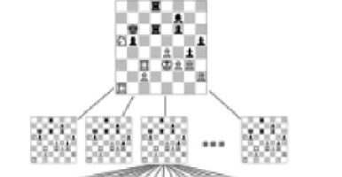
State evaluation function (or utility
value) is a very general and useful idea.
Example:
In chess, given a board, what would be the
perfect evaluation value that you would want to know?
(Assume the perspective of White player.)
A: f(board) → {+1, 0, -1}, with +1 for guaranteed win for White,
0 draw under perfect play, and
-1 loss under perfect play.
Perfect play: all powerful opponent.
Given f, how would you play then?
In practice, we only know (so far) of an approximation of f.
f(board) → [-1,+1] (interval from -1 to +1)
based on “values” of chess pieces, e.g., pawn 1 point, rook 5 points.
Informally, board value gives “probability (?) of winning.”

Slide 110

State evaluation function (or utility
value) is a very general and useful idea.
Examples:
TD-Gammon backgammon player. Neural net
was trained to find approximately optimal state (board)
evaluation values (range [-1,+1]). (Tesauro 1995)
“Robocopter” --- automated helicopter control;
trained state evaluation function.
State given by features, such as,
position, orientation, speed, and
rotors position and speed. Possible
actions change rotors speed and
position. Evaluation assigns value
in [-1,+1] to capture stability.
(Abbeel, Coates, and Ng 2008)

Slide 111
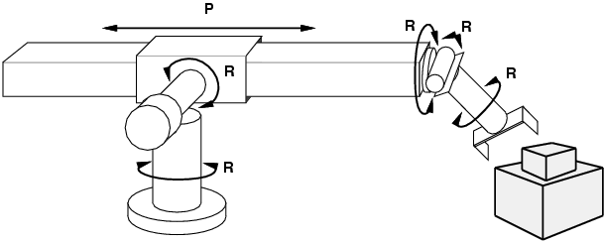
Example: Robotic assembly
states?: real-valued coordinates of robot joint angles
parts of the object to be assembled actions?: continuous motions of robot joints goal test?: complete assembly path cost?: time to execute

Slide 112
Other example search tasks
VLSI layout: positioning millions of components and connections on a chip to minimize area, circuit delays, etc.
Robot navigation / planning
Automatic assembly of complex objects
Protein design: sequence of amino acids that will fold into the 3-dimensional protein with the right properties.
Literally thousands of combinatorial search / reasoning / parsing /
matching problems can be formulated as search problems in exponential
size state spaces.

Slide 113
Search Techniques

Slide 114
Searching for a (shortest / least cost) path to goal state(s).
Search through the state space.
We will consider search techniques that use an
explicit search tree that is generated by the
initial state + successor function.
initialize (initial node)
Loop
choose a node for expansion according to strategy
goal node? → done
expand node with successor function

Slide 115
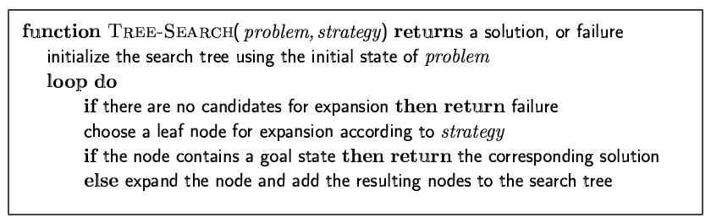
Tree-search algorithms
Basic idea:
simulated exploration of state space by generating successors of already-explored states (a.k.a. ~ expanding states)
Fig. 3.7 R&N, p. 77
Note: 1) Here we only check a node for possibly being a goal state, after we select the node for expansion.
2) A “node” is a data structure containing state + additional info (parent
node, etc.

Slide 116
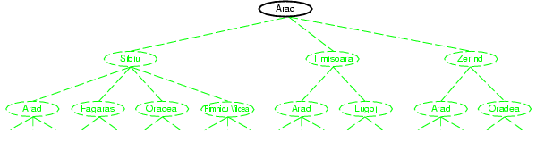
Tree search example
Node selected
for expansion.

Slide 117
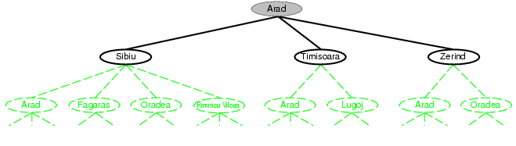
Nodes added to tree.

Slide 118
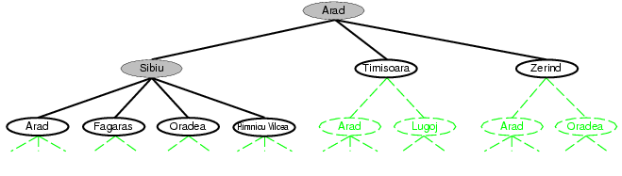
Selected for expansion.
Added to tree.
Note: Arad added (again) to tree!
(reachable from Sibiu)
Not necessarily a problem, but
in Graph-Search, we will avoid
this by maintaining an
“explored” list.

Slide 119
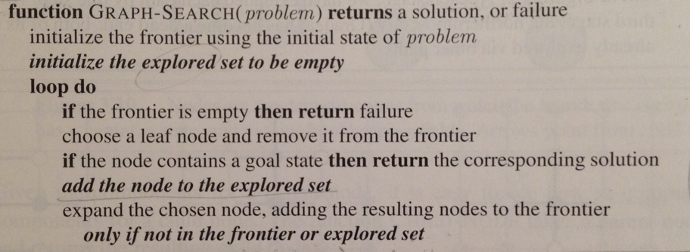
Graph-search
Fig. 3.7 R&N, p. 77. See also exercise 3.13.
Note:
1) Uses “explored” set to avoid visiting already explored states.
2) Uses “frontier” set to store states that remain to be explored and expanded.
3) However, with eg uniform cost search, we need to make a special check when
node (i.e. state) is on frontier. Details later.

Slide 120
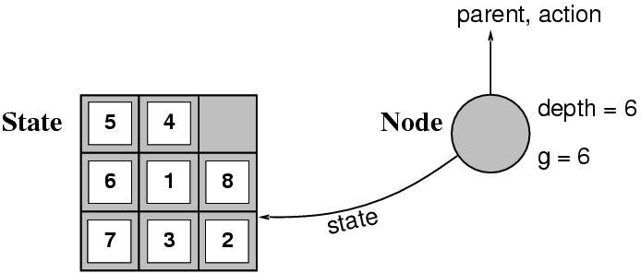
Implementation: states vs. nodes
A state is a --- representation of --- a physical configuration.
A node is a data structure constituting part of a search tree includes state, tree parent node, action (applied to parent), path cost (initial state to node) g(x), depth
The Expand function creates new nodes, filling in the various fields and using the SuccessorFn of the problem to create the corresponding states.
Fringe is the collection of nodes that have been generated but not (yet)
expanded. Each node of the fringe is a leaf node.

Slide 121
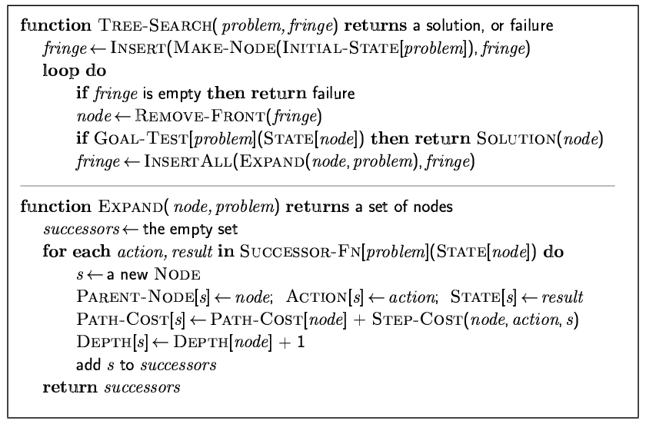
Implementation: general tree search

Slide 122
Search strategies
A search strategy is defined by picking the order of node expansion.
Strategies are evaluated along the following dimensions:
completeness: does it always find a solution if one exists?
time complexity: number of nodes generated
space complexity: maximum number of nodes in memory
optimality: does it always find a least-cost solution?
Time and space complexity are measured in terms of
b: maximum branching factor of the search tree
d: depth of the least-cost solution
m: maximum depth of the state space (may be ∞)

Slide 123
Uninformed search strategies
Uninformed (blind) search strategies use only the information available in the problem definition:
Breadth-first search
Uniform-cost search
Depth-first search
Depth-limited search
Iterative deepening search
Bidirectional search
Key issue: type of queue used for the fringe of the search tree
(collection of tree nodes that have been generated but not yet
expanded)

Slide 124
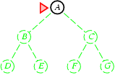
Breadth-first search
Expand shallowest unexpanded node.
Implementation:
fringe is a FIFO queue, i.e., new nodes go at end
(First In First Out queue.)
Fringe queue: <A>
Select A from
queue and expand.
Gives
<B, C>

Slide 125
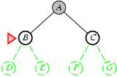
Queue: <B, C>
Select B from
front, and expand.
Put children at the
end.
Gives
<C, D, E>

Slide 126
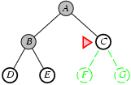
Fringe queue: <C, D, E>

Slide 127
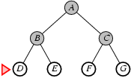
Fringe queue: <D, E, F, G>
Assuming no further children, queue becomes
<E, F, G>, <F, G>, <G>, <>. Each time node checked
for goal state.

Slide 128
Properties of breadth-first search
Note: check for
goal only when
node is expanded.
Complete? Yes (if b is finite)
Time? 1+b+b²+b³+… +b^{d} + b(b^{d}-1) = O(b^{d+1})
Space? O(b^{d+1}) (keeps every node in memory;
needed also to reconstruct soln. path)
Optimal soln. found?
Yes (if all step costs are identical)
Space is the bigger problem (more than time)
b: maximum branching factor of the search tree
d: depth of the least-cost solution

Slide 129
Uniform-cost search
Expand least-cost (of path to) unexpanded node
(e.g. useful for finding shortest path on map) Implementation:
fringe = queue ordered by path cost
Complete? Yes, if step cost ≥ ε (>0) Time? # of nodes with g ≤ cost of optimal solution (C*), O(b^{(1+⎣C*/ ε⎦})
Space? # of nodes with g ≤ cost of optimal solution,
O(b^{(1+⎣C*/ ε⎦})
Optimal? Yes – nodes expanded in increasing order of g(n)
Note: Some subtleties (e.g. checking for goal state).
See p 84 R&N. Also, next slide.
g – cost of reaching a node

Slide 130
Uniform-cost search
Two subtleties: (bottom p. 83 Norvig)
Do goal state test, only when a node is selected for expansion.
(Reason: Bucharest may occur on frontier with a longer than
optimal path. It won’t be selected for expansion yet. Other nodes
will be expanded first, leading us to uncover a shorter path to
Bucharest. See also point 2).
2) Graph-search alg. says “don’t add child node to frontier if already on
explored list or already on frontier.” BUT, child may give a shorter path
to a state already on frontier. Then, we need to modify the existing
node on frontier with the shorter path. See fig. 3.14 (else-if part).

Slide 131
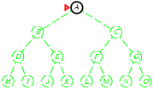
Depth-first search
“Expand deepest unexpanded node”
Implementation:
fringe = LIFO queue, i.e., put successors at front (“push on stack”)
Last In First Out
Fringe stack:
A
Expanding A,
gives stack:
B
C
So, B next.

Slide 132
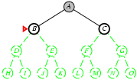
Expanding B, gives stack:
D
E
C
So, D next.

Slide 133
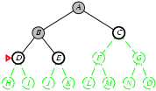
Expanding D, gives stack:
H
I
E
C
So, H next.
etc.

Slide 134
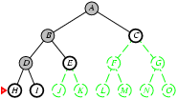

Slide 135
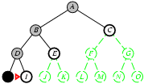

Slide 136
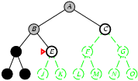

Slide 137
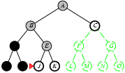

Slide 138


Slide 139


Slide 140


Slide 141


Slide 142


Slide 143
Properties of depth-first search
Complete?
Time? O(b^{m}): bad if m is much larger than d
but if solutions are dense, may be much faster than breadth-first
Space?
Guarantee that
opt. soln. is found?
No: fails in infinite-depth spaces, spaces with loops
Modify to avoid repeated states along path
→ complete in finite spaces
Note: Can also reconstruct soln. path from single stored branch.
O(bm), i.e., linear space!
b: max. branching factor of the search tree
d: depth of the shallowest (least-cost) soln.
m: maximum depth of state space
No
Note: In “backtrack search” only one successor is generated
→ only O(m) memory is needed; also successor is modification of
the current state, but we have to be able to undo each modification.
More when we talk about Constraint Satisfaction Problems (CSP).

Slide 144

Iterative deepening search
[here]

Slide 145

Iterative deepening search l =0

Slide 146

Iterative deepening search l =1

Slide 147

Iterative deepening search l =2

Slide 148

Iterative deepening search l =3

Slide 149
Why would one do that?
Combine good memory requirements of depth-first with
the completeness of breadth-first when branching factor is
finite and is optimal when the path cost is a non-decreasing
function of the depth of the node.
Idea was a breakthrough in game playing. All game
tree search uses iterative deepening nowadays. What’s
the added advantage in games?
“Anytime” nature.

Slide 150
Iterative deepening search
Number of nodes generated in an iterative deepening search to depth
d with branching factor b:
N_{IDS} = d b¹ + (d-1)b² + … + 3b^{d-2} +2b^{d-1} + 1b^{d}
Nodes generated in a breadth-first search with branching factor b:
N_{BFS} = b¹ + b² + … + b^{d-2} + b^{d-1} + b^{d}
For b = 10, d = 5,
N_{BFS}= 10 + 100 + 1,000 + 10,000 + 100,000 = 111,110
N_{IDS} = 50 + 400 + 3,000 + 20,000 + 100,000 = 123,456
Looks quite wasteful, is it?
☺
Iterative deepening is the preferred uninformed search method
when there is a large search space and the depth of the solution
is not known.

Slide 151
Properties of iterative deepening search
Complete? Yes (b finite)
Time? d b¹ + (d-1)b² + … + b^{d} = O(b^{d})
Space? O(bd)
Optimal? Yes, if step costs identical

Slide 152

Bidirectional Search
Simultaneously:
Search forward from start
Search backward from the goal
Stop when the two searches meet.
If branching factor = b in each direction,
with solution at depth d
➔ only O(2 b^{d/2})= O(2 b^{d/2})
Checking a node for membership in the other search tree can be done in constant time (hash table)
Key limitations:
Space O(b^{d/2})
Also, how to search backwards can be an issue (e.g., in Chess)? What’s tricky?
Problem: lots of states satisfy the goal; don’t know which one is relevant.
Aside: The predecessor of a node should be easily computable (i.e., actions are easily reversible).

Slide 153

Repeated states
Failure to detect repeated states can turn
linear problem into an exponential one!
Don’t return to parent node
Don’t generate successor = node’s parent
Don’t allow cycles
Don’t revisit state
Keep every visited state in memory! O(b^{d}) (can be expensive)
Problems in which actions are reversible (e.g., routing problems or sliding-blocks puzzle). Also, in eg Chess; uses hash tables to check
for repeated states. Huge tables 100M+ size but very useful.
See Tree-Search vs. Graph-Search in Fig. 3.7 R&N. But need to
be careful to maintain (path) optimality and completeness.

Slide 154
Summary: General, uninformed search
Original search ideas in AI where inspired by studies of human problem solving in, eg, puzzles, math, and games, but a great many AI tasks now require some form of search (e.g. find optimal agent strategy; active learning; constraint reasoning; NP-complete problems require search).
Problem formulation usually requires abstracting away real-world details to define a state space that can feasibly be explored.
Variety of uninformed search strategies
Iterative deepening search uses only linear space and not much more time than other uninformed algorithms.
Avoid repeating states / cycles.

Slide 155
References
Agents in Artificial Intelligence – GeeksforGeeks
Problem Solving In Artificial Intelligence | Artificial Intelligence Tutorial (minigranth.in)
Reasoning in Artificial Intelligence - Javatpoint
Deductive Reasoning Examples (yourdictionary.com)

Slide 156
Natural Language Processing Introduction
Unit-2

Slide 157
Natural Language Processing
NLP is the branch of computer science focused on developing systems that allow computers to communicate with people using everyday language.
Also called Computational Linguistics
Also concerns how computational methods can aid the understanding of human language

Slide 158
Related Areas
Artificial Intelligence
Formal Language (Automata) Theory
Machine Learning
Linguistics
Psycholinguistics
Cognitive Science
Philosophy of Language

Slide 159
Communication
The goal in the production and comprehension of natural language is communication.
Communication for the speaker:
Intention: Decide when and what information should be transmitted (a.k.a. strategic generation). May require planning and reasoning about agents’ goals and beliefs.
Generation: Translate the information to be communicated (in internal logical representation or “language of thought”) into string of words in desired natural language (a.k.a. tactical generation).
Synthesis: Output the string in desired modality, text or speech.

Slide 160
Communication (cont)
Communication for the hearer:
Perception: Map input modality to a string of words, e.g. optical character recognition (OCR) or speech recognition.
Analysis: Determine the information content of the string.
Syntactic interpretation (parsing): Find the correct parse tree showing the phrase structure of the string.
Semantic Interpretation: Extract the (literal) meaning of the string (logical form).
Pragmatic Interpretation: Consider effect of the overall context on altering the literal meaning of a sentence.
Incorporation: Decide whether or not to believe the content of the string and add it to the KB.

Slide 161
Communication (cont)

Slide 162
Syntax, Semantic, Pragmatics
Syntax concerns the proper ordering of words and its affect on meaning.
The dog bit the boy.
The boy bit the dog.
* Bit boy dog the the.
Colorless green ideas sleep furiously.
Semantics concerns the (literal) meaning of words, phrases, and sentences.
“plant” as a photosynthetic organism
“plant” as a manufacturing facility
“plant” as the act of sowing
Pragmatics concerns the overall communicative and social context and its effect on interpretation.
The ham sandwich wants another beer. (co-reference, anaphora)
John thinks vanilla. (ellipsis)

Slide 163

Modular Comprehension
Pragmatics
Acoustic/
Phonetic
Syntax
Semantics
sound
waves
words
parse
trees
literal
meaning
meaning
(contextualized)

Slide 164

Ambiguity
Natural language is highly ambiguous and must be disambiguated.
I saw the man on the hill with a telescope.
I saw the Grand Canyon flying to LA.
Time flies like an arrow.
Horse flies like a sugar cube.
Time runners like a coach.
Time cars like a Porsche.

Slide 165
Ambiguity is Ubiquitous
Speech Recognition
“recognize speech” vs. “wreck a nice beach”
“youth in Asia” vs. “euthanasia”
Syntactic Analysis
“I ate spaghetti with chopsticks” vs. “I ate spaghetti with meatballs.”
Semantic Analysis
“The dog is in the pen.” vs. “The ink is in the pen.”
“I put the plant in the window” vs. “Ford put the plant in Mexico”
Pragmatic Analysis
From “The Pink Panther Strikes Again”:
Clouseau: Does your dog bite? Hotel Clerk: No. Clouseau: [bowing down to pet the dog] Nice doggie. [Dog barks and bites Clouseau in the hand] Clouseau: I thought you said your dog did not bite! Hotel Clerk: That is not my dog.

Slide 166
Ambiguity is Explosive
Ambiguities compound to generate enormous numbers of possible interpretations.
In English, a sentence ending in n prepositional phrases has over 2^{n} syntactic interpretations (cf. Catalan numbers).
“I saw the man with the telescope”: 2 parses
“I saw the man on the hill with the telescope.”: 5 parses
“I saw the man on the hill in Texas with the telescope”: 14 parses
“I saw the man on the hill in Texas with the telescope at noon.”: 42 parses
“I saw the man on the hill in Texas with the telescope at noon on Monday” 132 parses
166
Notes:
166

Slide 167
Humor and Ambiguity
Many jokes rely on the ambiguity of language:
Groucho Marx: One morning I shot an elephant in my pajamas. How he got into my pajamas, I’ll never know.
She criticized my apartment, so I knocked her flat.
Noah took all of the animals on the ark in pairs. Except the worms, they came in apples.
Policeman to little boy: “We are looking for a thief with a bicycle.” Little boy: “Wouldn’t you be better using your eyes.”
Why is the teacher wearing sun-glasses. Because the class is so bright.

Slide 168
Why is Language Ambiguous?
Having a unique linguistic expression for every possible conceptualization that could be conveyed would make language overly complex and linguistic expressions unnecessarily long.
Allowing resolvable ambiguity permits shorter linguistic expressions, i.e. data compression.
Language relies on people’s ability to use their knowledge and inference abilities to properly resolve ambiguities.
Infrequently, disambiguation fails, i.e. the compression is lossy.

Slide 169
Natural Languages vs. Computer Languages
Ambiguity is the primary difference between natural and computer languages.
Formal programming languages are designed to be unambiguous, i.e. they can be defined by a grammar that produces a unique parse for each sentence in the language.
Programming languages are also designed for efficient (deterministic) parsing, i.e. they are deterministic context-free languages (DCLFs).
A sentence in a DCFL can be parsed in O(n) time where n is the length of the string.

Slide 170
Natural Language Tasks
Processing natural language text involves many various syntactic, semantic and pragmatic tasks in addition to other problems.

Slide 171
Syntactic Tasks

Slide 172
Word Segmentation
⊗
Breaking a string of characters (graphemes) into a sequence of words.
In some written languages (e.g. Chinese) words are not separated by spaces.
Even in English, characters other than white-space can be used to separate words [e.g. , ; . - : ( ) ]
Examples from English URLs:
jumptheshark.com ⇒ jump the shark .com
myspace.com/pluckerswingbar
⇒ myspace .com pluckers wing bar
⇒ myspace .com plucker swing bar

Slide 173
Morphological Analysis
Morphology is the field of linguistics that studies the internal structure of words. (Wikipedia)
A morpheme is the smallest linguistic unit that has semantic meaning (Wikipedia)
e.g. “carry”, “pre”, “ed”, “ly”, “s”
Morphological analysis is the task of segmenting a word into its morphemes:
carried ⇒ carry + ed (past tense)
independently ⇒ in + (depend + ent) + ly
Googlers ⇒ (Google + er) + s (plural)
unlockable ⇒ un + (lock + able) ?
⇒ (un + lock) + able ?

Slide 174
Part Of Speech (POS) Tagging
Annotate each word in a sentence with a part-of-speech.
Useful for subsequent syntactic parsing and word sense disambiguation.
I ate the spaghetti with meatballs.
Pro V Det N Prep N
John saw the saw and decided to take it to the table.
PN V Det N Con V Part V Pro Prep Det N

Slide 175
Phrase Chunking
Find all non-recursive noun phrases (NPs) and verb phrases (VPs) in a sentence.
[NP I] [VP ate] [NP the spaghetti] [PP with] [NP meatballs].
[NP He ] [VP reckons ] [NP the current account deficit ] [VP will narrow ] [PP to ] [NP only # 1.8 billion ] [PP in ] [NP September ]

Slide 176

Syntactic Parsing
Produce the correct syntactic parse tree for a sentence.

Slide 177
Semantic Tasks

Slide 178
Word Sense Disambiguation (WSD)
Words in natural language usually have a fair number of different possible meanings.
Ellen has a strong interest in computational linguistics.
Ellen pays a large amount of interest on her credit card.
For many tasks (question answering, translation), the proper sense of each ambiguous word in a sentence must be determined.

Slide 179
Semantic Role Labeling (SRL)
For each clause, determine the semantic role played by each noun phrase that is an argument to the verb.
agent patient source destination instrument
John drove Mary from Austin to Dallas in his Toyota Prius.
The hammer broke the window.
Also referred to a “case role analysis,” “thematic analysis,” and “shallow semantic parsing”

Slide 180
Semantic Parsing
A semantic parser maps a natural-language sentence to a complete, detailed semantic representation (logical form).
For many applications, the desired output is immediately executable by another program.
Example: Mapping an English database query to Prolog:
How many cities are there in the US?
answer(A, count(B, (city(B), loc(B, C),
const(C, countryid(USA))),
A))

Slide 181
Textual Entailment
Determine whether one natural language sentence entails (implies) another under an ordinary interpretation.

Slide 182
Textual Entailment Problems from PASCAL Challenge
TEXT | HYPOTHESIS | ENTAIL MENT
Eyeing the huge market potential, currently led by Google, Yahoo took over search company Overture Services Inc last year. | Yahoo bought Overture. | TRUE
Microsoft's rival Sun Microsystems Inc. bought Star Office last month and plans to boost its development as a Web-based device running over the Net on personal computers and Internet appliances. | Microsoft bought Star Office. | FALSE
The National Institute for Psychobiology in Israel was established in May 1971 as the Israel Center for Psychobiology by Prof. Joel. | Israel was established in May 1971. | FALSE
Since its formation in 1948, Israel fought many wars with neighboring Arab countries. | Israel was established in 1948. | TRUE

Slide 183
Pragmatics/Discourse Tasks

Slide 184
Anaphora Resolution/ Co-Reference
Determine which phrases in a document refer to the same underlying entity.
John put the carrot on the plate and ate it.
Bush started the war in Iraq. But the president needed the consent of Congress.
Some cases require difficult reasoning.
Today was Jack's birthday. Penny and Janet went to the store. They were going to get presents. Janet decided to get a kite. "Don't do that," said Penny. "Jack has a kite. He will make you take it back."

Slide 185
Ellipsis Resolution
"Wise men talk because they have something to say;
fools talk because they have to say something.“ (Plato)
"Wise men talk because they have something to say;
fools, because they have to say something.“ (Plato)
Frequently words and phrases are omitted from sentences when they can be inferred from context.

Slide 186
Other Tasks

Slide 187
Information Extraction (IE)
187
Identify phrases in language that refer to specific types of entities and relations in text.
Named entity recognition is task of identifying names of people, places, organizations, etc. in text.
people organizations places
Michael Dell is the CEO of Dell Computer Corporation and lives in Austin Texas.
Relation extraction identifies specific relations between entities.
Michael Dell is the CEO of Dell Computer Corporation and lives in Austin Texas.
Notes:
187

Slide 188
Question Answering
Directly answer natural language questions based on information presented in a corpora of textual documents (e.g. the web).
When was Barack Obama born? (factoid)
August 4, 1961
Who was president when Barack Obama was born?
John F. Kennedy
How many presidents have there been since Barack Obama was born?
9

Slide 189
Text Summarization
Produce a short summary of a longer document or article.
Article: With a split decision in the final two primaries and a flurry of superdelegate endorsements, Sen. Barack Obama sealed the Democratic presidential nomination last night after a grueling and history-making campaign against Sen. Hillary Rodham Clinton that will make him the first African American to head a major-party ticket. Before a chanting and cheering audience in St. Paul, Minn., the first-term senator from Illinois savored what once seemed an unlikely outcome to the Democratic race with a nod to the marathon that was ending and to what will be another hard-fought battle, against Sen. John McCain, the presumptive Republican nominee….
Summary: Senator Barack Obama was declared the presumptive Democratic presidential nominee.

Slide 190
Machine Translation (MT)
Translate a sentence from one natural language to another.
Hasta la vista, bebé ⇒
Until we see each other again, baby.

Slide 191
Ambiguity Resolution is Required for Translation
Syntactic and semantic ambiguities must be properly resolved for correct translation:
“John plays the guitar.” → “John toca la guitarra.”
“John plays soccer.” → “John juega el fútbol.”
An apocryphal story is that an early MT system gave the following results when translating from English to Russian and then back to English:
“The spirit is willing but the flesh is weak.” ⇒ “The liquor is good but the meat is spoiled.”
“Out of sight, out of mind.” ⇒ “Invisible idiot.”

Slide 192
Resolving Ambiguity
Choosing the correct interpretation of linguistic utterances requires knowledge of:
Syntax
An agent is typically the subject of the verb
Semantics
Michael and Ellen are names of people
Austin is the name of a city (and of a person)
Toyota is a car company and Prius is a brand of car
Pragmatics
World knowledge
Credit cards require users to pay financial interest
Agents must be animate and a hammer is not animate

Slide 193
Manual Knowledge Acquisition
Traditional, “rationalist,” approaches to language processing require human specialists to specify and formalize the required knowledge.
Manual knowledge engineering, is difficult, time-consuming, and error prone.
“Rules” in language have numerous exceptions and irregularities.
“All grammars leak.”: Edward Sapir (1921)
Manually developed systems were expensive to develop and their abilities were limited and “brittle” (not robust).

Slide 194
Automatic Learning Approach
Use machine learning methods to automatically acquire the required knowledge from appropriately annotated text corpora.
Variously referred to as the “corpus based,” “statistical,” or “empirical” approach.
Statistical learning methods were first applied to speech recognition in the late 1970’s and became the dominant approach in the 1980’s.
During the 1990’s, the statistical training approach expanded and came to dominate almost all areas of NLP.

Slide 195
Learning Approach
Machine
Learning
Manually Annotated
Training Corpora
Linguistic
Knowledge
NLP System
Raw Text
Automatically
Annotated Text

Slide 196
Advantages of the Learning Approach
Large amounts of electronic text are now available.
Annotating corpora is easier and requires less expertise than manual knowledge engineering.
Learning algorithms have progressed to be able to handle large amounts of data and produce accurate probabilistic knowledge.
The probabilistic knowledge acquired allows robust processing that handles linguistic regularities as well as exceptions.

Slide 197
The Importance of Probability
Unlikely interpretations of words can combine to generate spurious ambiguity:
“The a are of I” is a valid English noun phrase (Abney, 1996)
“a” is an adjective for the letter A
“are” is a noun for an area of land (as in hectare)
“I” is a noun for the letter I
“Time flies like an arrow” has 4 parses, including those meaning:
Insects of a variety called “time flies” are fond of a particular arrow.
A command to record insects’ speed in the manner that an arrow would.
Some combinations of words are more likely than others:
“vice president Gore” vs. “dice precedent core”
Statistical methods allow computing the most likely interpretation by combining probabilistic evidence from a variety of uncertain knowledge sources.

Slide 198
Human Language Acquisition
Human children obviously learn languages from experience.
However, it is controversial to what extent prior knowledge of “universal grammar” (Chomsky, 1957) facilitates this acquisition process.
Computational studies of language learning may help us to understand human language learning, and to elucidate to what extent language learning must rely on prior grammatical knowledge due to the “poverty of the stimulus.”
Existing empirical results indicate that a great deal of linguistic knowledge can be effectively acquired from reasonable amounts of real linguistic data without specific knowledge of a “universal grammar.”

Slide 199
Pipelining Problem
Assuming separate independent components for speech recognition, syntax, semantics, pragmatics, etc. allows for more convenient modular software development.
However, frequently constraints from “higher level” processes are needed to disambiguate “lower level” processes.
Example of syntactic disambiguation relying on semantic disambiguation:
At the zoo, several men were showing a group of students various types of flying animals. Suddenly, one of the students hit the man with a bat.

Slide 200
Pipelining Problem (cont.)
If a hard decision is made at each stage, cannot backtrack when a later stage indicates it is incorrect.
If attach “with a bat” to the verb “hit” during syntactic analysis, then cannot reattach it to “man” after “bat” is disambiguated during later semantic or pragmatic processing.

Slide 201
Increasing Module Bandwidth
If each component produces multiple scored interpretations, then later components can rerank these interpretations.
Pragmatics
Acoustic/
Phonetic
Syntax
Semantics
sound
waves
meaning
(contextualized)
words
parse
trees
literal
meanings
Problem: Number of interpretations grows combinatorially.
Solution: Efficiently encode combinations of interpretations.
Word lattices
Compact parse forests

Slide 202
Global Integration/ Joint Inference
Integrated interpretation that combines phonetic/syntactic/semantic/pragmatic constraints.
Integrated
Interpretation
sound
waves
meaning
(contextualized)
Difficult to design and implement.
Potentially computationally complex.

